Slide 1
THE CIRCULAR ECONOMY
Mărian Yasmine
Let's find out more together
Lacatușu Edurd

Slide 2
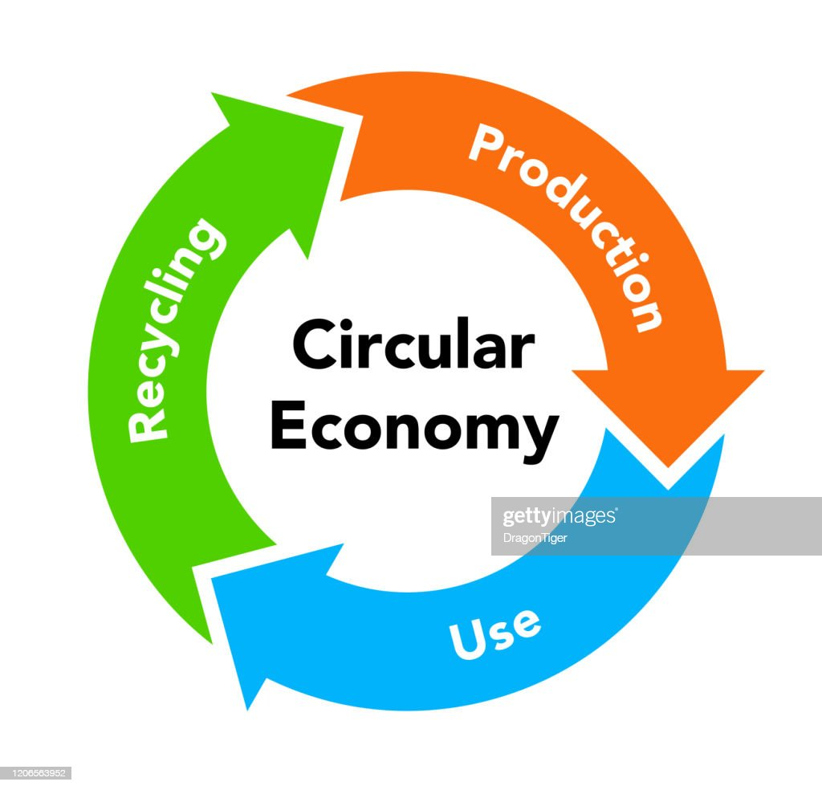
Tree principles of the circular economy?
Eliminate waste and pollution
Circulate products and materials (at their highest value)
Regenerate nature
What is a circular economy?
In our current economy, we take materials from the Earth, make products from them, and eventually throw them away as waste – the process is linear. In a circular economy, by contrast, we stop waste being produced in the first place.

Slide 3
FOOD
OVERVIEW
Featured circular economy examples:
Nature-positive food production, more diversity, reduction of food losses, the transformation of organic by-products into useful materials and products are all key ingredients of a circular economy for food. Take your time savouring these delicious examples from every corner of the globe.

Slide 4
Prevent
Donate
Discharge
Food for animals
Recycle
Other forms of

Slide 5
Danemark
Italy and France
Food waste in some
countries
Denmark has recently launched a store concept - WeFood - which picks up surplus food from supermarkets and sells it to low-income people at prices up to 50% lower.
Italy is about to pass a law requiring supermarkets to donate expiring products to charity. It would be the second European state to give the green light to such regulation after France, the country where retailers are banned from throwing away any product that has not been sold.

Slide 6
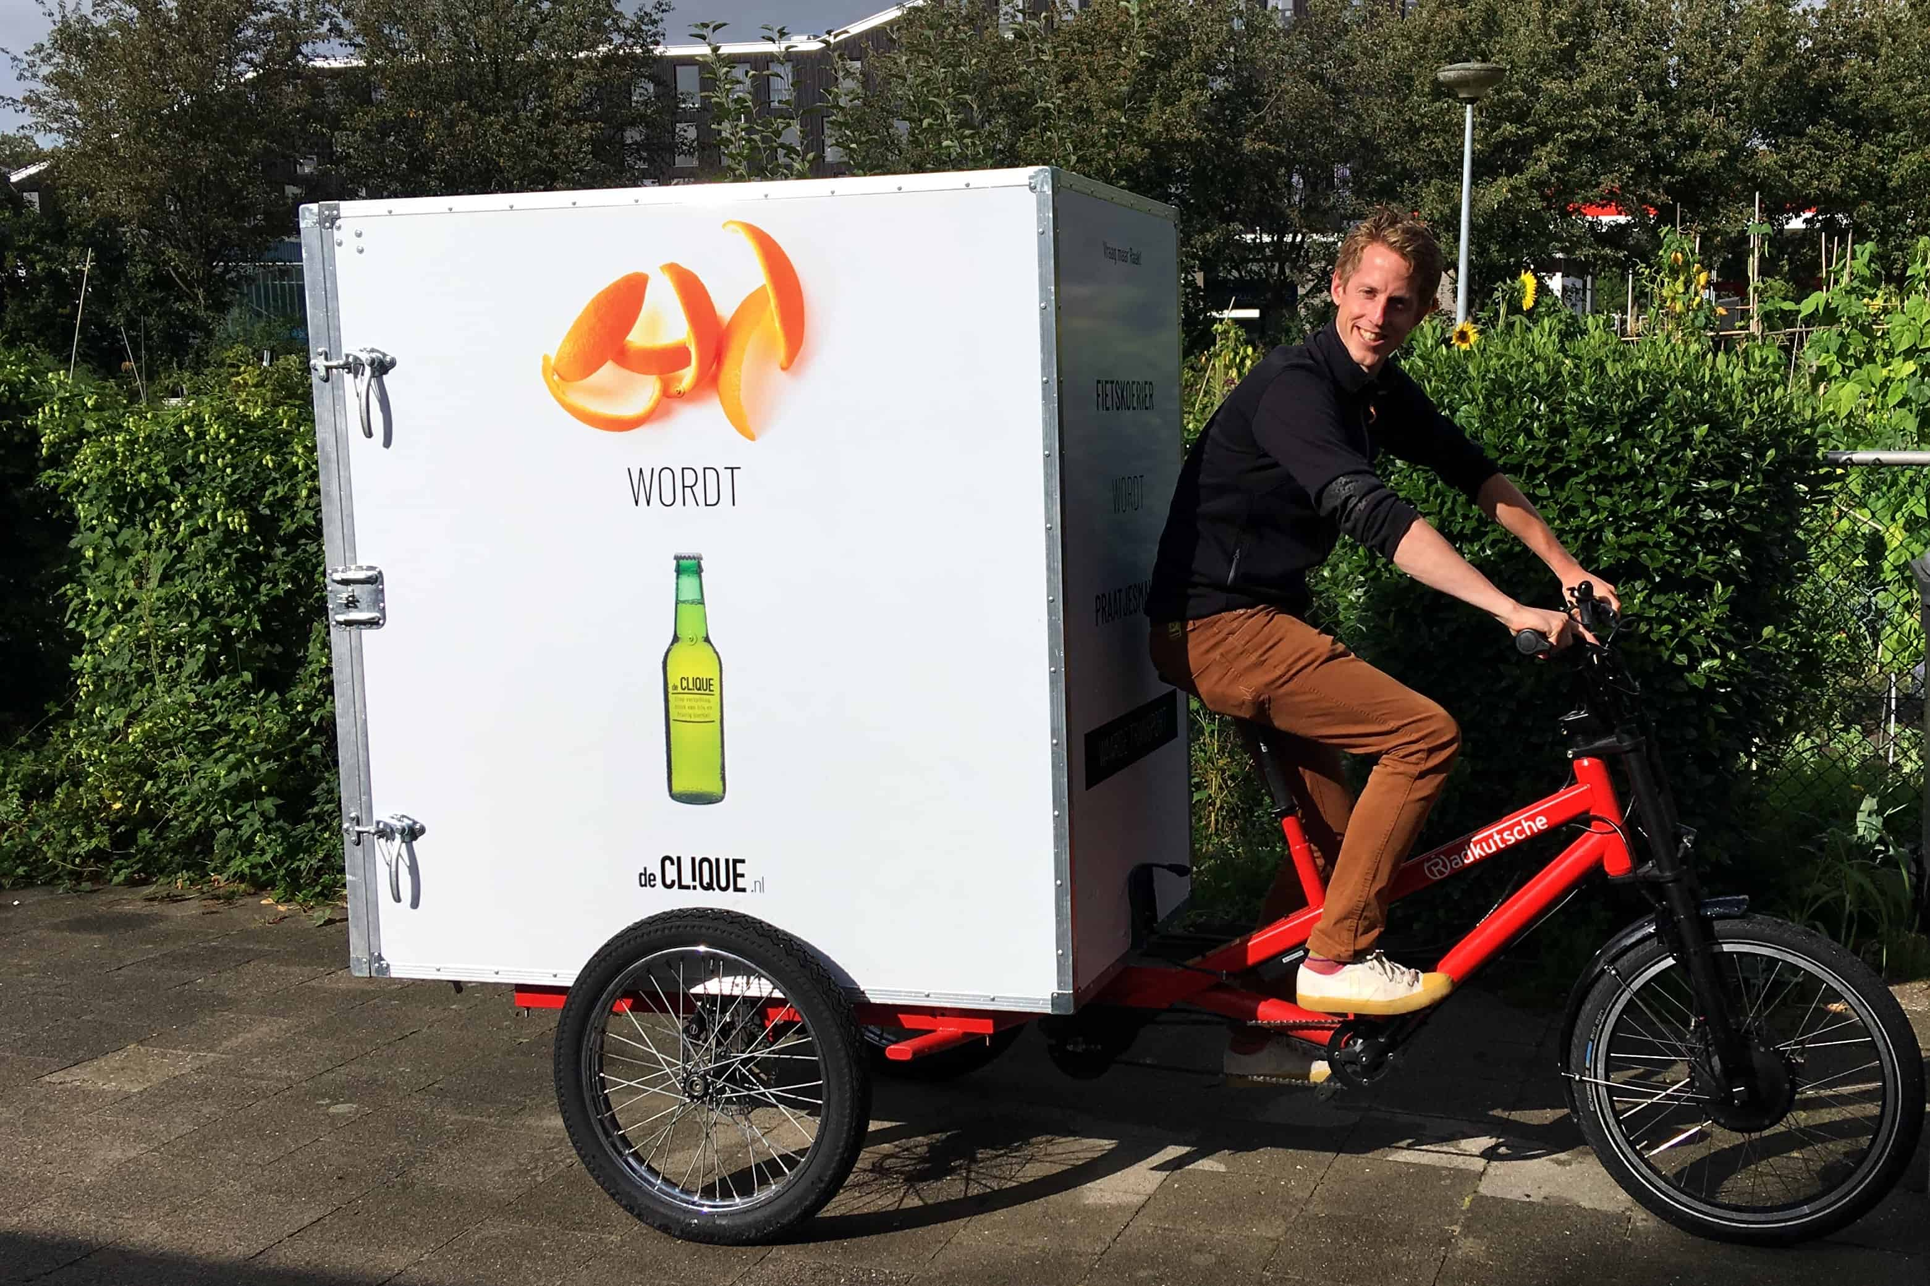
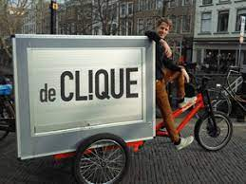
Making new products from urban organic waste streams: De Clique
Origin: Netherlands
Using cycle couriers and electric vehicles, De Clique collects food by-products like coffee grounds, orange peels and other food waste from businesses.
Collected as pure waste streams, these by-products are then sold on by De Clique to third party innovators and product manufacturers, who transform them into new products like food ingredients, cosmetics, and biomaterials.
“We are working towards zero-waste cities in which all residual flows are reused.”

Slide 7
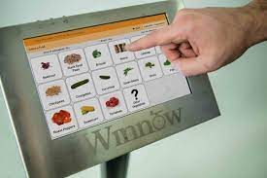
Reducing food waste, increasing profits: Winnow
How does Winnow enable the circular economy?
Winnow was founded with a simple belief that food is too valuable to waste.
According to the UN, up to a third of all food that is produced in the world is lost or wasted, with an estimated value of USD 1 trillion discarded each year. Furthermore, greenhouse gas emissions from decomposition of post-consumer organic waste is responsible for 5% of global emissions. The elimination of food waste is a cornerstone of a circular economy for food.
By providing an easy way to weigh, categorise and analyse the underlying reasons for food waste, Winnow’s technology increases awareness in kitchen staff, facilitating better decision making in menu design and food preparation, so that less food is thrown away.
Origin: London

Slide 8
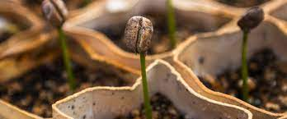
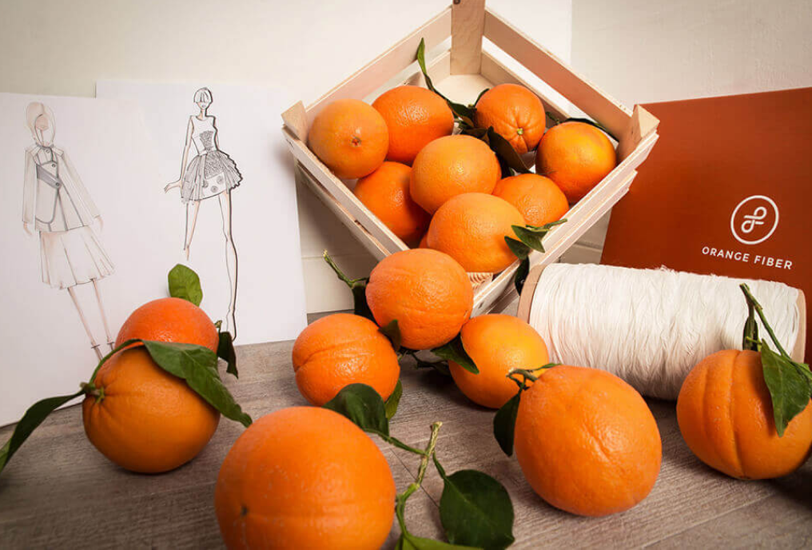
High value products from organic waste
Fabrics from Oranges
The Mediterranean island of Sicily has the perfect conditions for cultivating oranges and other citrus fruit, which local companies then convert into food and beverage products. In Italy, 700,000 tonnes of citrus by-product are generated each year. Through imagination and an understanding of chemistry and material science, entrepreneurial companies like Orange Fiber are realising that these discarded resources are in fact feedstock for high quality materials of the future.
Origin:Italy

Slide 9
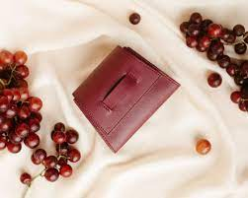
Paper from pasta by-products
Leather from Grapes
If there is one food that is the symbol of Italian cuisine, it is pasta. From long threads of spaghetti to flat sheets of lasagne, most pasta types are produced from the flour of durum wheat, a very hard grain made of a tough outer bran and a starchy inner endosperm (also referred to as semolina). Enter Favini, a company that had already been successful in producing a line of paper called Crush using citrus fruit peels, lavender stems, coffee grains, and other food by-products. Barilla approached Favini to explore making a paper from the bran residue that they could not use in pasta production. The result is a fine paper called CartaCrusca, which contains 20% bran residue, replacing cellulose and filler materials from virgin sources.
A Milan-based architect called Gianpiero Tessitore realised that wine by-products also contain fibrous materials that can be used to make leather-type fabrics. Tessitore, in collaboration with a number of research centres and the University of Florence, has patented a wine leather production method, setting up a company called Vegea to commercialise his ‘grape leather’. The new material has got many big brands interested, not just fashion but also companies like Chevrolet, Honda, and Volkswagen, that now produce cars with vegan interiors.

Slide 10
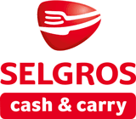
The measures taken by the most important retailers in Romania in order to reduce food waste.
KAUFLAND
In every Kaufland store, you can see discounted products gradually, until the liquidation of critical items. Gradual discounts are applied for the liquidation of critical term items, up to the value of 0.01 lei. The reduced goods are placed and signaled accordingly for the clients. With regard to expiring items, we are guided by two basic principles: at Kaufland, we do not sell items that are on the last day of validity and the basic regulation is "Kaufland does not throw away food".
SELGROS
"The table of joy is a project founded by Selgros with the Romanian Patriarchate in 2009. It distributes food in perfect condition for consumption, but which for various reasons can no longer be used in the economic process (goods with short shelf life, Improper packaging, overproduction) The principle of operation is as follows: at least once a week, representatives of the Romanian Patriarchate pick up donated food from Selgros stores and distribute it to social centers and canteens, as needed. of valid products, such as staple foods (oil, sugar, flour, rice, pasta), cheese, dairy, soft drinks, sweets.From the start of the project until now, Selgros donations total about 3,9 million euros ".
PROFI
“Increasing the number of deliveries from suppliers to ensure the freshness of food, optimizing orders based on sales and reducing the selling price for products that have only a few days until the end of the shelf life. In the mentioned situation, there are mainly articles from the categories of dairy products, semi-prepared foods, vegetables and fruits ".

Slide 11
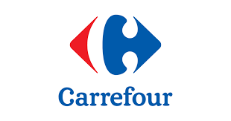
CARREFOUR
MEGA IMAGE
“Food products whose expiration date is approaching the deadline are sold, according to the law, at a reduced price, or donated to non-governmental organizations. Among the implemented projects are the shelf of fresh products, a project through which we sell fresh salads and juices prepared in the store from a mix of vegetables and fruits already present there, thus optimizing the quantities. At the moment, the project is being implemented in over 180 Mega Image stores and is helping us significantly reduce the amount of vegetables and fruits before they expire.”
“Foods, but also non-food products, which can no longer be marketed (eg have damaged packaging) but are still valid and good for consumption, but also foods that are approaching the expiration date are donated to the largest partners being the Romanian Patriarchate (the „The table of Joy" project) and the "Smile of the Angels" association (for the "Midnight Sandwich" project). In addition, products that are about to expire are offered for sale at a reduced price. Last but not least, we develop partnerships through which goods that are good for consumption but which can no longer be sold can be directed to people at risk (homeless people, poor people). Moreover, non-consumable products, food waste“

Slide 12
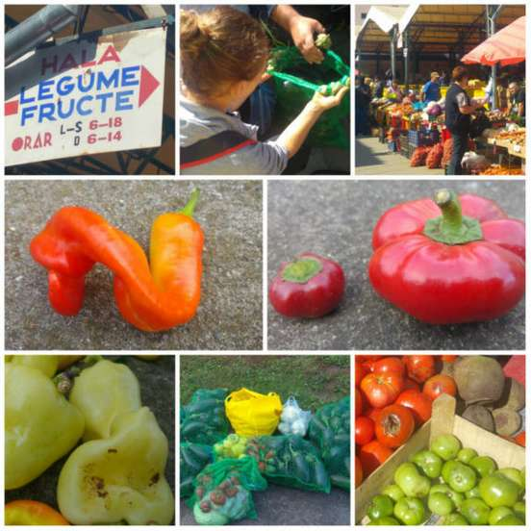
No waste- fight food waste in Aiud, Romania
Every Thursday, farmers from villages near Aiud come to the town’s weekly fair to sell vegetables, fruits, and dairy products. The farmers arrive early in the morning and leave at noon. On the rest of the weekdays, you can mainly find distributors, which import fruits and vegetables and sell them.
A group of young people living in Aiud started a project called “Fara Risipa” (Zero Waste) whose tagline is “Don’t throw away ugly food that doesn’t sell. Give it to a poor family in Aiud”. In three months, they collected over 800 kilograms of vegetables, which they donated to more than 60 people.
When the first group of volunteers arrived in the Aiud market on a Thursday morning last September to ask the farmers if they wanted to donate the vegetables that didn’t sell, but were still edible, instead of throwing them away, they received an unexpected reaction. “Why are you coming only now?”

Slide 13
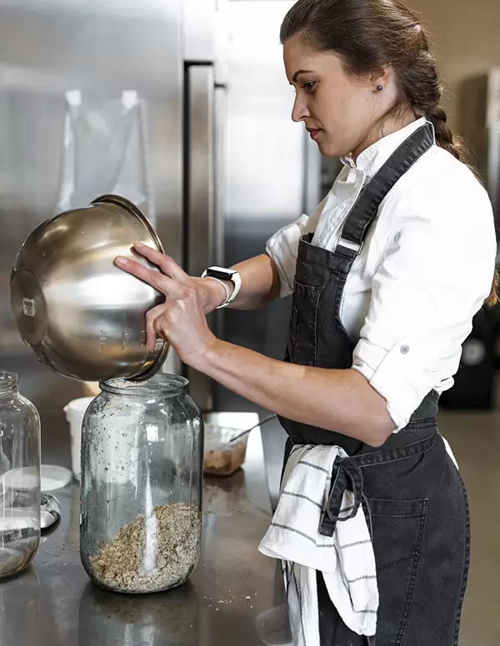
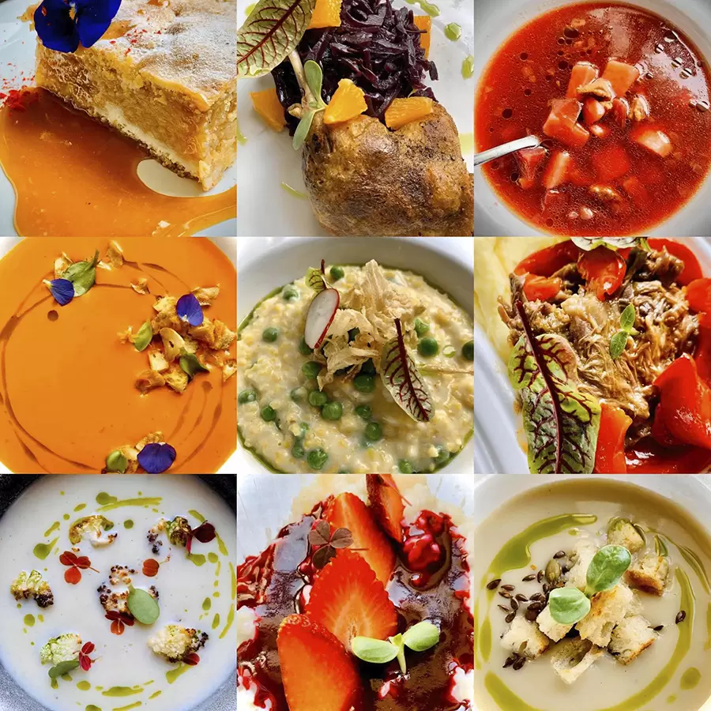
The first Romanian restaurant to promote the concept of zero food waste
"Zero food waste means that we try to capitalize on almost everything that exists in the kitchen in terms of raw materials," says Madalina. "From the peels of vegetables and fruits, to the falls from the pieces of meat, the bread that is no longer fresh, the coffee grounds, etc. We make syrup from quince peels, stocks or chips from vegetable peels, chips from coffee grounds, puree from apple peels with turmeric and mustard. Bread or cozonac (romanian traditional sweet bread) is reused in a pudding, a very popular dessert in the area, we make stocks of meat bones, etc. "
Madalina Santa recently returned to Romania, after a longer period of time spent abroad, and opened the Szikra restaurant in Sfântu Gheorghe, which surprised the Romanian hospitality market with a unique concept: a zero food waste menu.
But Madalina's project is not limited to food. Her restaurant offers a number of details in the field of sustainability, such as stainless steel straws, textile towels in the bathroom, glass recycling, use of as few plastic bags, a container dedicated to compost and other small but important details for the eco operation of the place.

Slide 14
SOMARO collects products such as food and essential household products, as well as clothing, footwear, shoes, etc. from different companies and sells them at symbolic prices, with significant discounts, to low-income customers. The entire range offered in SOMARO stores includes products that are 100% suitable for consumption but cannot be sold in other stores due to damaged or dirty packaging, as they will soon expire or for other reasons. SOMARO's objective is to acquire the financial resources necessary to cover its operations through the sale of products. As they are donated, the beneficiaries pay only the salaries of the staff and the minimum additional expenses.
SOMARO Association, Social Store

Slide 15
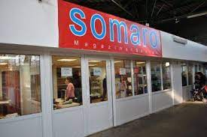
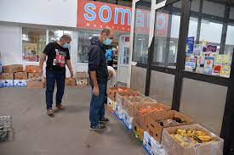
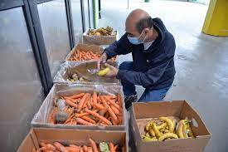
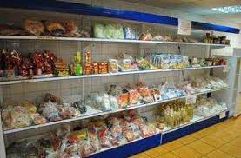

Slide 16
Conclusions
Transitioning to a circular economy means moving towards a food system that builds natural capital and allows nature to thrive.
Regenerative food production means growing food in ways that generate positive outcomes for nature such as healthy and stable soils, improved local biodiversity, improved air and water quality.
It is implemented through practices tailored to local contexts such as using diverse crop varieties and cover crops, rotational grazing, and agroforestry (growing trees around or among crops or pasture) and results in agricultural land that more closely resembles natural ecosystems like forest and native grassland, providing habitat for a wide range of organisms.
With the circular economy, we can build a food system that ensures our food never creates waste.
It prevents food waste, redistribute surplus edible food to people who need it and inedible food by-products and human waste become inputs for new products.
Changing our food system to one based on the principles of the circular economy is one of the most powerful things we can do to tackle climate change and build biodiversity. We can achieve this and provide healthy nutritious food for all.
The current food system doesn’t work for everyone, and it certainly doesn’t work for the environment. Industrial farming has turned agriculture into a leading source of greenhouse gas emissions and pollution, and is driving the extinction of species.
Not only do we produce food in a way that won’t work in the long term, but we also waste almost a third of it while nearly 10% of the world’s population go hungry.

